Slide 1


Personal Journal Platform: A Visual Studio Development Journey
This presentation explores the journey of building a personal journal platform, from its initial concept to implementation and future enhancements. We'll delve into the technologies involved, including Visual Studio, JavaScript, HTML, and CSS, and explore how these elements contribute to a seamless and engaging user experience.
by GOPICA H 231801043

Slide 2
Introduction to the Project
Purpose
Target Audience
The goal is to create a user-friendly platform where individuals can easily record and manage their thoughts, experiences, and ideas in a secure and private environment.
The platform is designed for individuals seeking a personal space to express themselves, organize their thoughts, and track their personal growth.

Slide 3
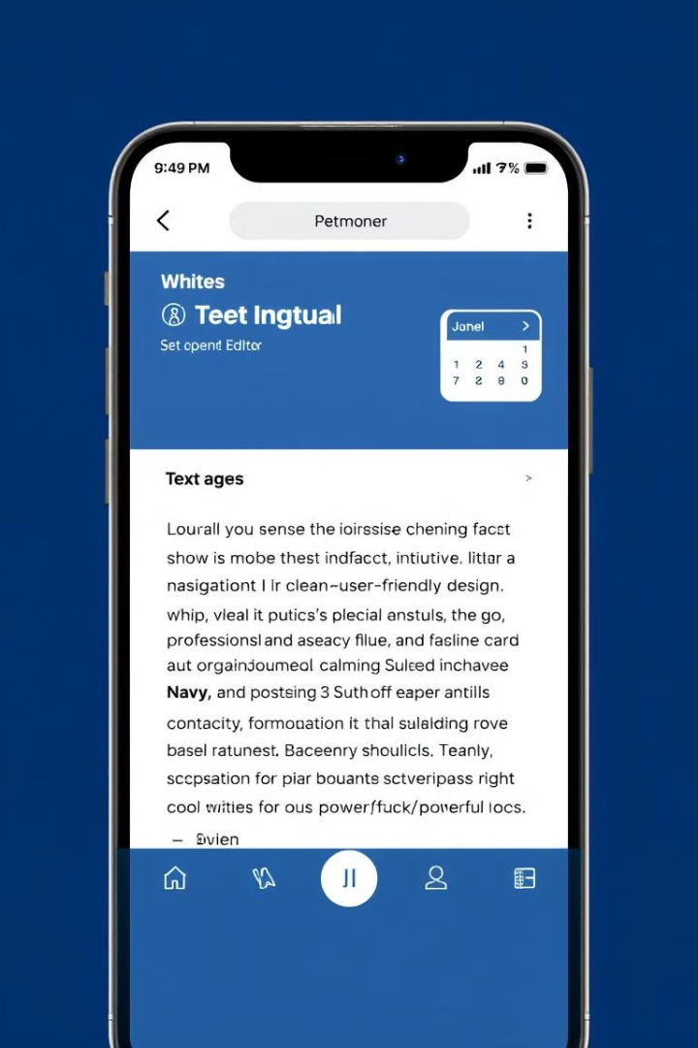
Key Features
Secure Storage
Customization
Sensitive personal entries are protected with robust encryption and password security measures.
Users can personalize their journal with various themes, fonts, and layouts to create a unique experience.
Calendar Integration
Multimedia Support
Effortlessly view and navigate past entries, organize by date, and reflect on past experiences.
Integrate images, audio recordings, and other media to enrich journal entries and create a dynamic experience.

Slide 4
Leveraging Visual Studio and Related Tools
Visual Studio Code
Integrated Development Environment
A lightweight and versatile IDE offering robust features for coding, debugging, and collaboration, optimized for JavaScript, HTML, and CSS.
Visual Studio provides a powerful and comprehensive ecosystem for development, including a debugger, code editor, and integrated version control system.

Slide 5




Building the Platform with JavaScript, HTML, and CSS
JavaScript
The backbone of the platform, handling dynamic behavior, user interactions, and data manipulation.
HTML
Defines the structure and content of the journal interface, organizing elements and text.
CSS
Styles the visual appearance of the platform, controlling layout, colors, fonts, and overall aesthetics.

Slide 6




Exploring Frameworks like React.js and Vue.js
1
Component-Based Architecture
React.js and Vue.js
2
These frameworks offer a component-based approach, breaking down the user interface into reusable components, leading to faster development and improved maintainability.
Virtual DOM
3
React.js and Vue.js utilize a virtual DOM, which optimizes performance by efficiently updating only the necessary elements on the page.
Data Binding
4
These frameworks simplify data management with features like two-way data binding, ensuring consistent data updates across the application.

Slide 7
Creating an Engaging User Experience
Intuitive Navigation
1
The platform prioritizes ease of use, with clear menus, intuitive interactions, and familiar design patterns.
Visually Appealing Design
2
A clean, uncluttered interface and visually appealing elements promote focus and reduce distractions for the user.
Personalized Experience
3
Users can personalize their journal with custom themes, fonts, and layout options to create a unique and comfortable experience.

Slide 8





Challenges and Solutions in Development
Data Security
Implementing robust encryption and authentication measures to protect sensitive user data.
Performance Optimization
Minimizing loading times and ensuring smooth interactions by optimizing code and using efficient algorithms.
Cross-Browser Compatibility
Testing the platform across different browsers to ensure consistent functionality and aesthetics for all users.
User Feedback
Gathering and responding to user feedback to improve the platform and address any usability issues.

Slide 9
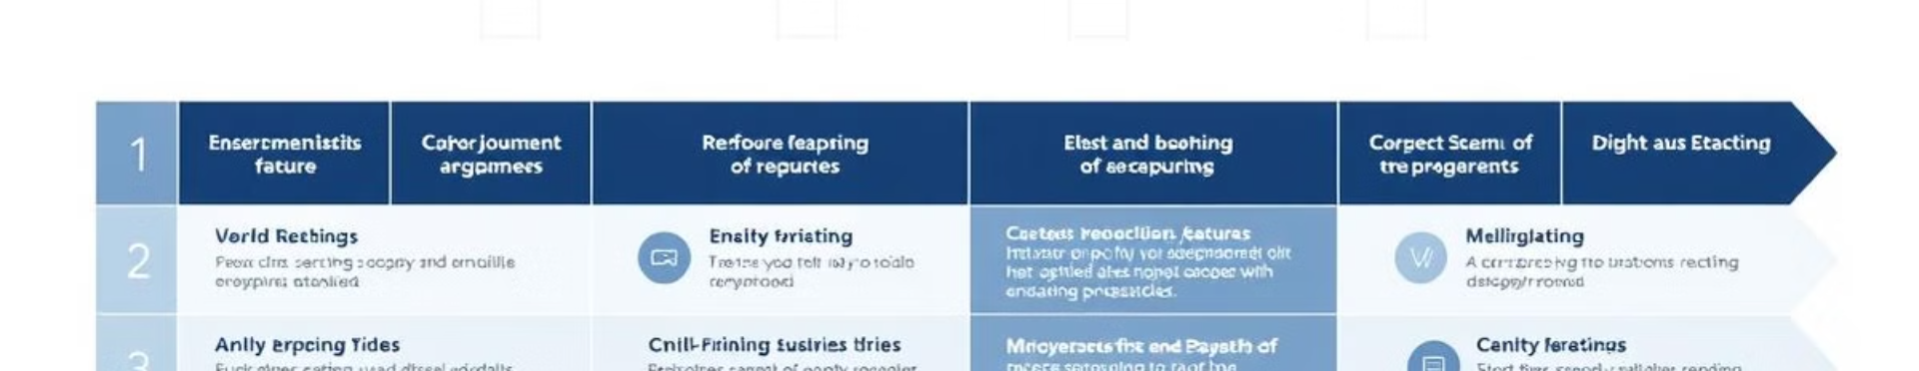
Future Enhancements and Roadmap
1
2
3
AI Integration
Collaborative Features
Mobile App Development
Explore AI-powered features for content suggestions, automatic organization, and personalized insights.
Introduce the ability for users to share their journals with trusted individuals, fostering connection and support.
Expand the platform's reach by creating a mobile app, enabling users to access their journals on the go.

